Slide 1
Image-Based Situation Awareness Audit 28.2.2018
Sakari Lampola

Slide 2
Previous Audit 11.1.2018

Slide 3
Open questions:
Role of classical object tracking alrorithms?
What to do with multiple bounding boxes around one object?
Appropriate minimum confidence level?
What to do with false detections inside other objects?
What to do with false detections from the background?
How to set Kalman filter parameters for image object filtering?
Hungarian algorithm, special case for hidden objects
To do:
Close open questions
Image object status
Image object velocity estimation
Probabilistic approach for matching detected and image objects
2d -> 3d transformation
World object state estimation
Other:
Semantic segmentation
Organisations to follow: ICCV, ICRA, NIPS, IROS, arXiv
Camera motion (yaw, pitch,roll)
Grid or continuous presentation?
Class specific attributes
Object history
Previous Audit

Slide 4
Project Plan

Slide 5

Project Plan
Methodology / Preparation of research infra
Software platforms are constructed and tested
Off-the-shelf models are acquired and tested
Necessary skills on platforms are learned
Methodology / Method survey
Current state-of-art methods are studied
Methods are constructed and tested on the software platforms
Method follow-up
Screening of conference papers related to the subject
Possibly integrating new methods to the project

Slide 6
Work Done

Slide 7

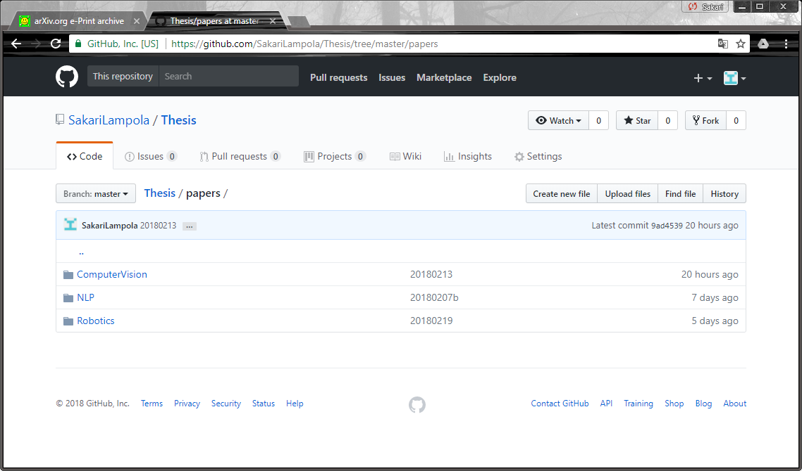
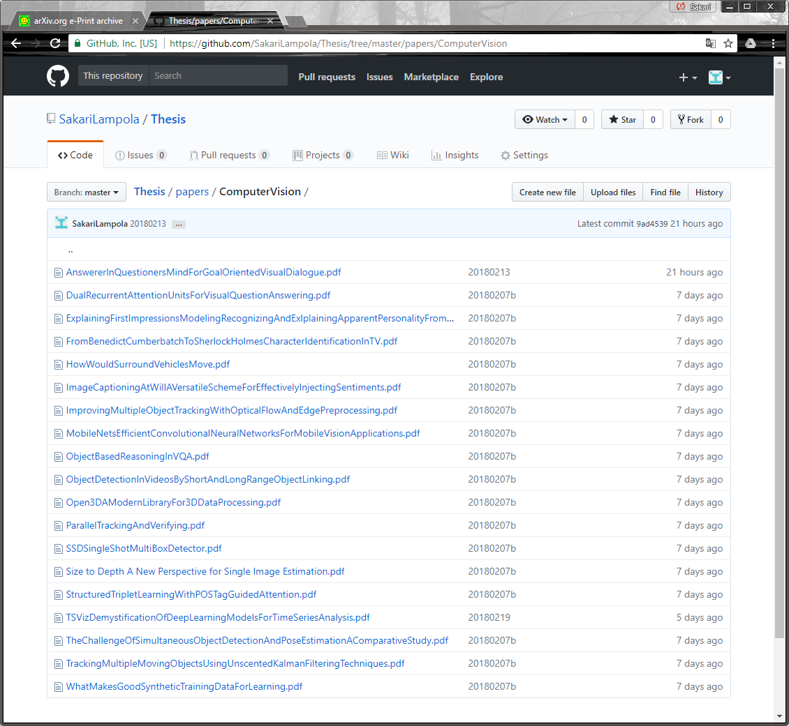
Method Follow-Up

Slide 8
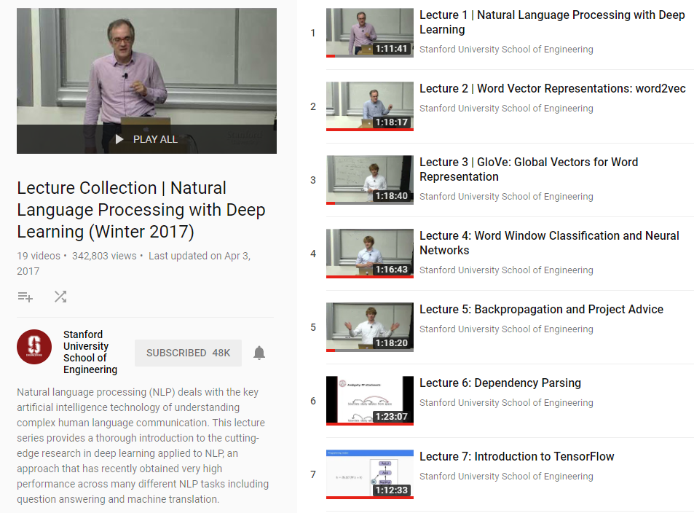
Method Survey
Christoffer Manning & Richard Socher

Slide 9
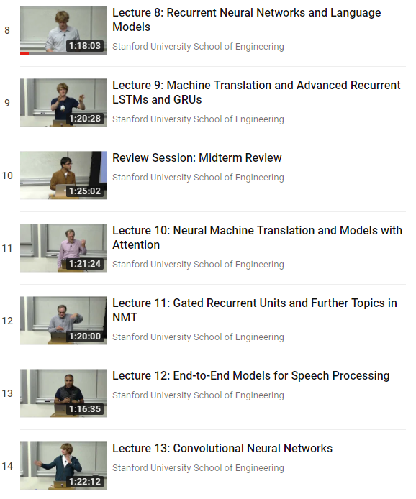
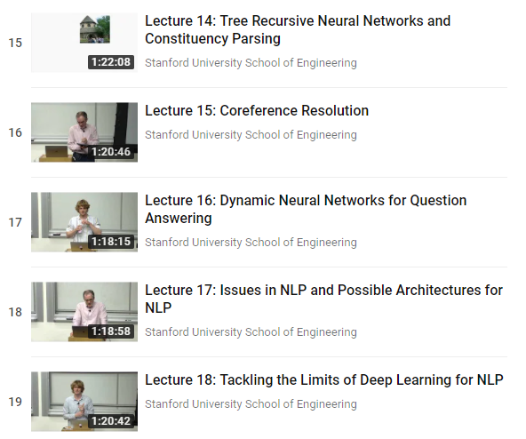
Method Survey
Goodfellow, Bengio, Courville: Deep Learning

Slide 10
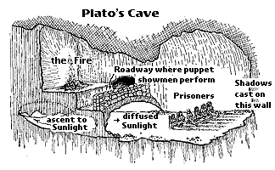
V2.0 Goal
Detected classes not hardcoded
Object class may change
Support for many cameras , rotations, movement
Names less awkward, terminology fixed
Cleaning
Python style guide followed, excluding line length
Code optimization
One package
Speech synthesizer
Software Version 2.0
Name of the software package: ShadowWorld
(Plato: Allegory of the Cave)

Slide 11
Class Diagram
Software Version 2.0
PresentationForecast
PresentationMap
PresentationLog
…
Presentation
Speech
Synthesizer
World
Camera
”World object”
”Image object”
”Detected object”
Event
Body
Pattern
Detection
Trace
Forecast
Bounding
Box

Slide 12
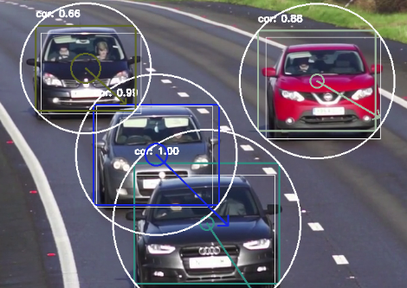
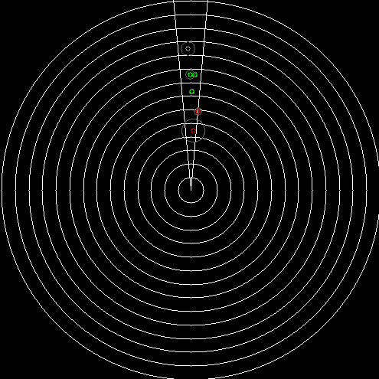
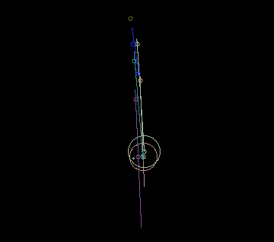
Detection
Software Version 2.0
Matching
Pattern Filtering
Distance Estimation
3D Projection
Body Filtering
Body Prediction
Collision Detection

Slide 13
Speech Synthesizer
Software Version 2.0
pyttsx3
Speech
Synthesizer
World
Event
Event
time
priority
text
(object)
Speech synthesizer based on pyttsx3 package
Event is spelled out if priority <= 0
Event will pause video for the duration of speech (to be changed later by using separate thread)
Example events:
Body observed (1 sec after created)
Collision warning

Slide 14
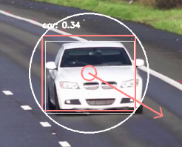
Visual Presentation (pattern)
Software Version 2.0
class
confidence
bounding box (filtered)
bounding circle (calculated from bounding box)
center point velocity (pixels/sec)
center point (calculated from bounding box)
detection
center point confidence (ellipse, axes=2*standard deviation)

Slide 15
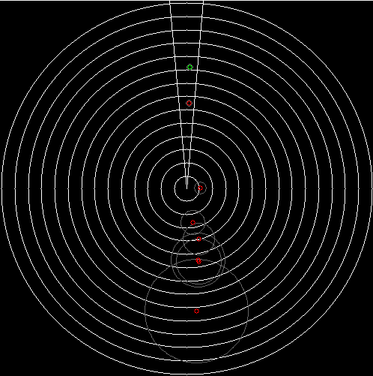
Visual Presentation (body)
camera field of view
Software Version 2.0
body (green, with reliable pattern)
body (red, with unreliable or lost pattern)
observer (+camera)
distance circles (every 10m)
location uncertainty (ellipse, axes = standard deviation)
body size (circle, radius = class specific mean radius)

Slide 16
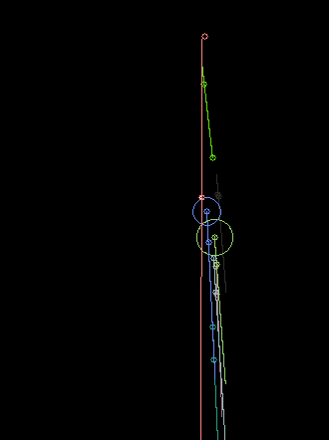
Visual Presentation (forecast)
Forecast made every FORECAST_INTERVAL (=1.0) seconds
Software Version 2.0
observer
body location, when forecast was made
body location, current
body location predicted path (line)
body location after FORECAST_COUNT*FORECAST_DELTA seconds
collision probability > 1
body size (circle, radius = class specific mean radius)

Slide 17
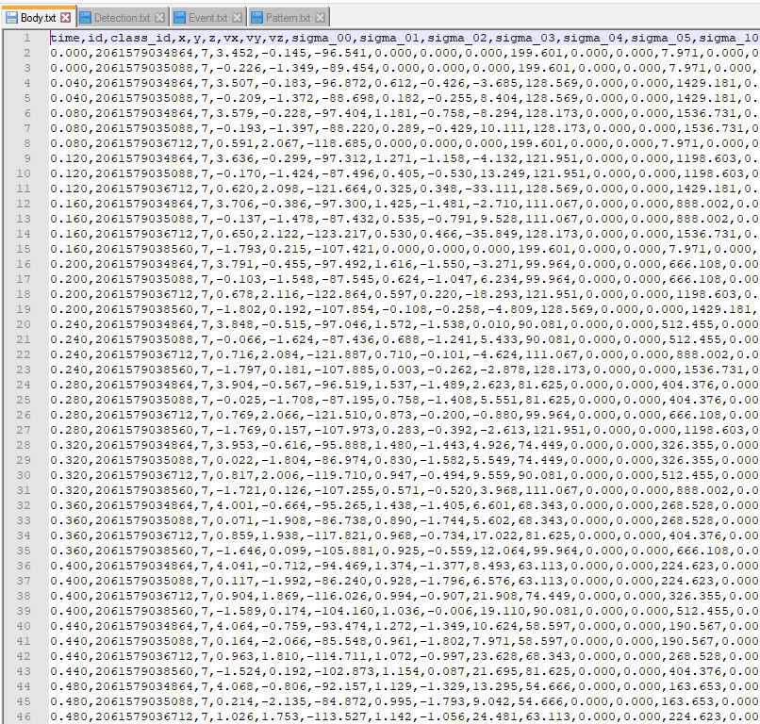
Logging
Software Version 2.0

Slide 18
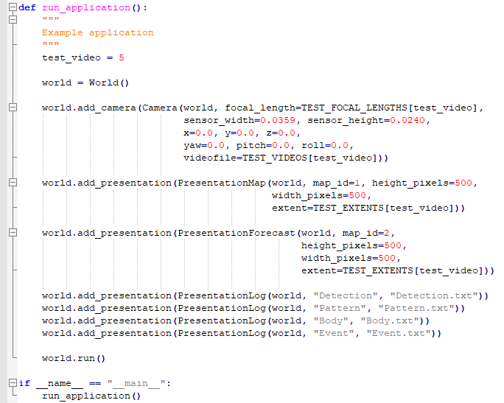
How to use?
Software Version 2.0
Demo
3-5 videos
Short program code review

Slide 19
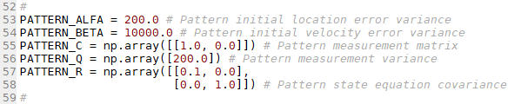
Why pattern filtering?
Reduces object detection noise (bounding box)
Provides prediction for pattern location in the next frame - matching easier
Predicts pattern location when detection is missing
Pattern Filtering
Hyperparameters:

Slide 20
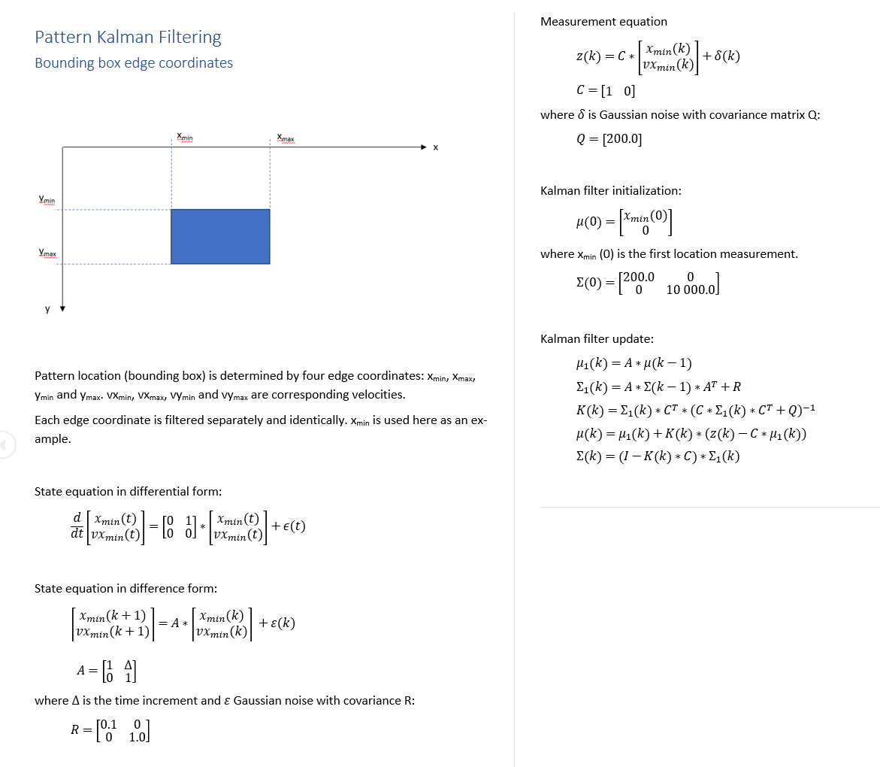
Pattern Filtering

Slide 21
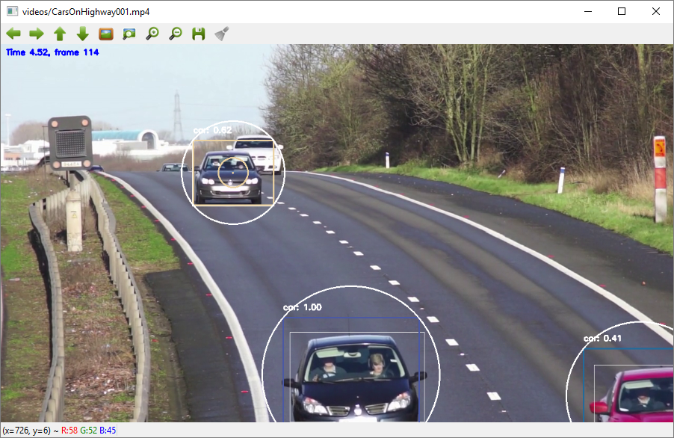
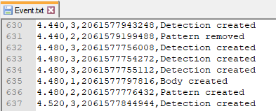
Example:
Pattern Filtering

Slide 22
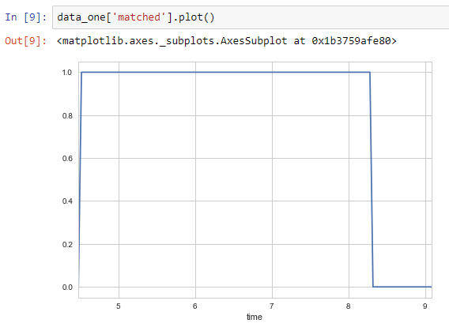
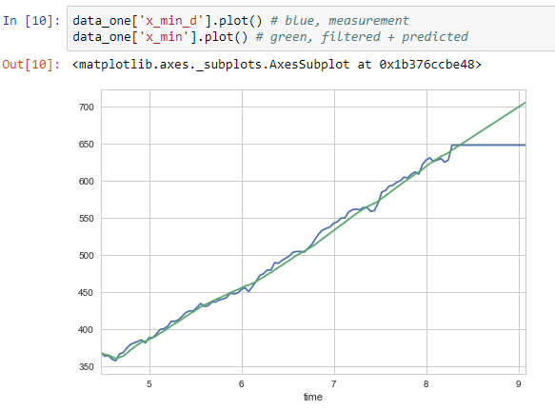
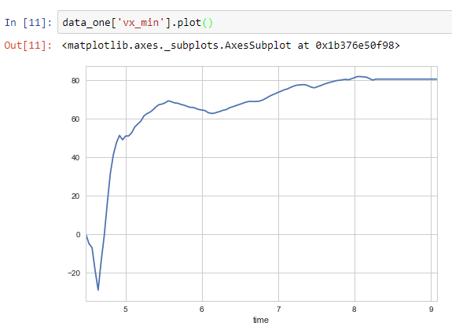
Matched status, coordinate and velocity
Pattern Filtering

Slide 23
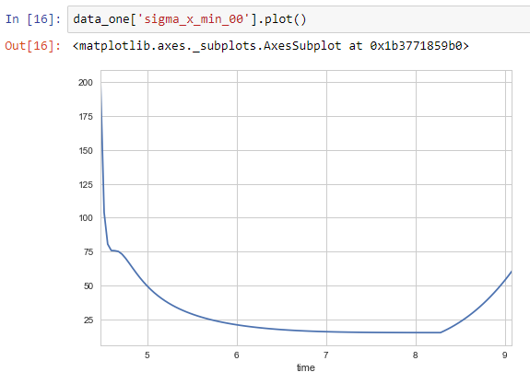
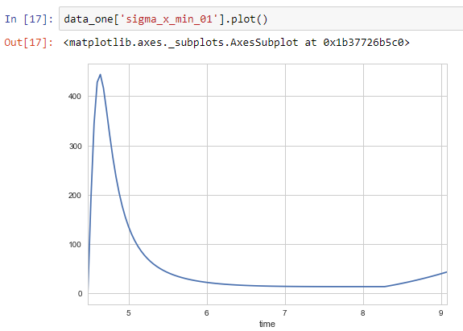
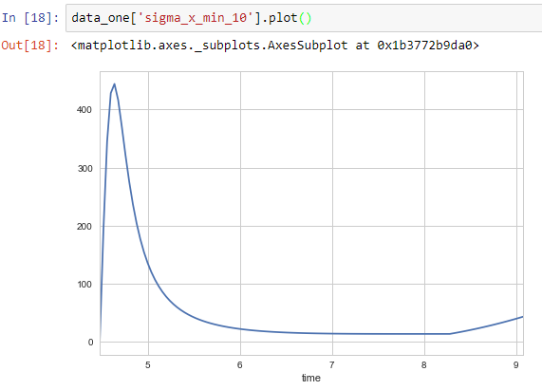
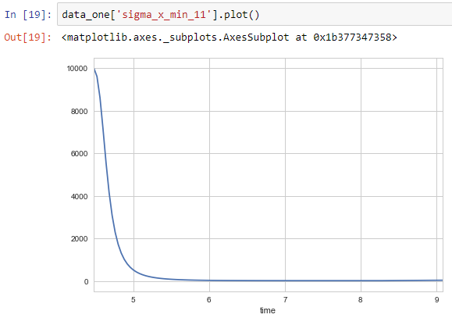
Covariance matrix
(0=location, 1=velocity)
Pattern Filtering

Slide 24
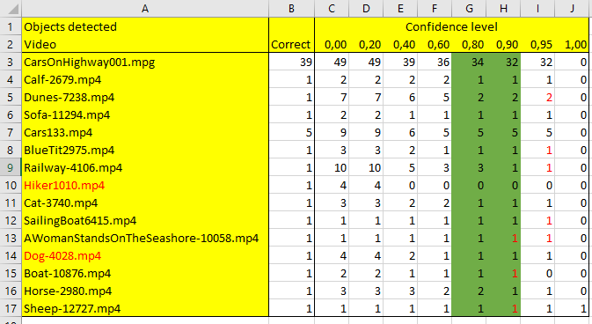
Minimum confidence level to create a pattern (and body) was varied between 0 and 1. The number of bodies created was compared to
the true number of objects in the video.
Matching / Confidence Level
Good value for creating a new pattern is between 0.8 and 0.9.

Slide 25
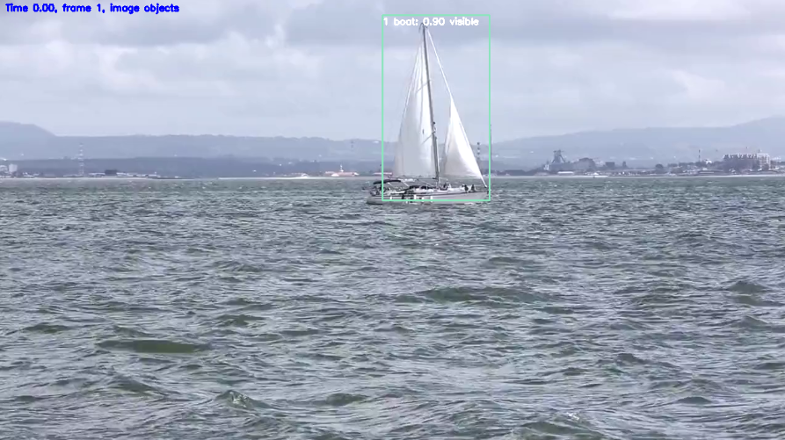
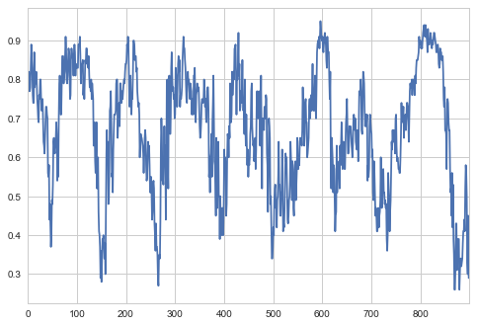
Matching / Confidence Level
Confidence level has dynamics
create
update
ignore
Different levels for creating and updating image object.
Hyperparameters:
CONFIDENCE_LEVEL_CREATE (0.8)
CONFIDENCE_LEVEL_UPDATE (0.2)

Slide 26
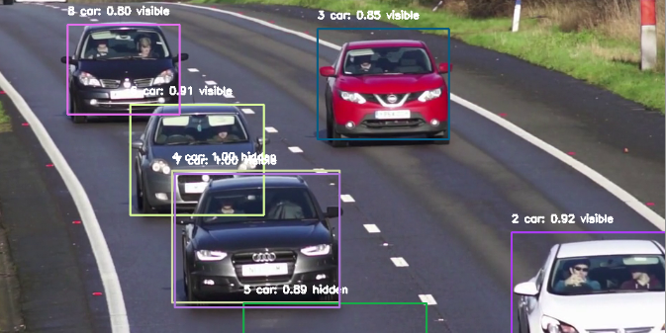
The problem: Bounding box size and form are distorded near edges
Matching / Border Behaviour
Hyperparameter BORDER_WIDTH (30)

Slide 27
Matching / Border Behaviour
1
2
3
4
5
6
Reliable
Reliable
Unreliable, not created
Reliable, not created
Unreliable, not created
Unreliable, removed
Done for:
left
right
top
bottom
If a pattern touches 3 borders, it is removed
Reliable = body information updated

Slide 28
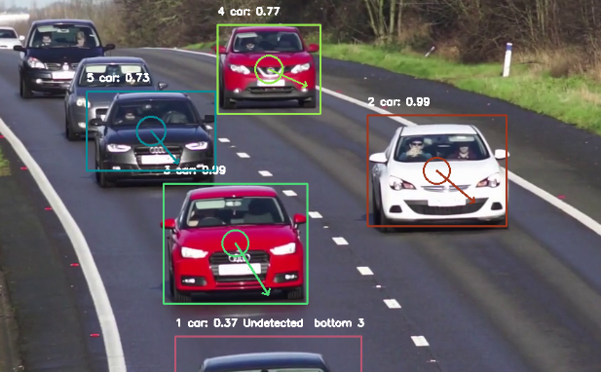
Matching / Pattern Retention
Patterns are removed if not detected in RETENTION_COUNT_MAX (30) successive frames. Body continues to live.

Slide 29
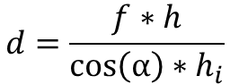
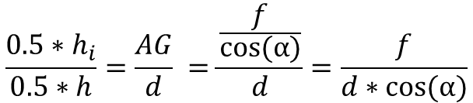
d (distance)=AF
D
Distance Estimation
F
h
E
C
G
h_{i}
α
A
B
f
Similar triangles AGE and AFD:
$$\frac{{0.5∗h}_{i}}{0.5∗h}=\frac{AG}{d} =\frac{\frac{f}{cos⁡(α)}}{d}=\frac{f}{d∗cos⁡(α)}$$
$$d=\frac{f∗h}{{\cos\left(α\right)∗h}_{i}}$$

Slide 30
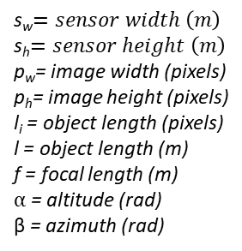
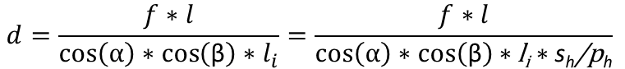
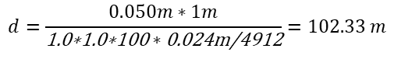
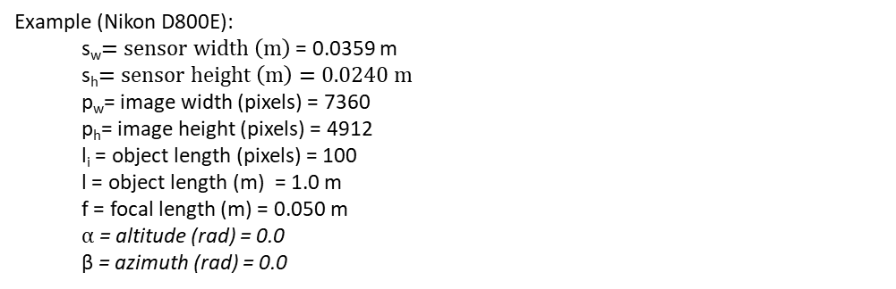
Similar equations for horizontal direction (β=azimuth):
Distance Estimation
s_{w}$=sensor width \left(m\right)$
s_{h}$=sensor height \left(m\right)$
p_{w}= image width (pixels)
p_{h}= image height (pixels)
l_{i} = object length (pixels)
l = object length (m)
f = focal length (m)
$α$ = altitude (rad)
β = azimuth (rad)
$$d=\frac{f∗l}{{\cos\left(α\right)∗\cos\left(\text{β}\right)∗l}_{i}}=\frac{f∗l}{\cos\left(α\right)∗\cos\left(\text{β}\right)∗\text{l}\text{i}∗\text{s}\text{h}\text{/}\text{p}\text{h}}$$
Assumptions:
equal vertical/horizontal pixel spacing
optical axis in image center
Example (Nikon D800E):
s_{w}$=sensor width \left(m\right)$ = 0.0359 m
s_{h}$=sensor height \left(m\right)=0.0240 m$
p_{w}= image width (pixels) = 7360
p_{h}= image height (pixels) = 4912
l_{i} = object length (pixels) = 100
l = object length (m) = 1.0 m
f = focal length (m) = 0.050 m
$α$ = altitude (rad) = 0.0
β = azimuth (rad) = 0.0
$$d=\frac{0.050m∗1m}{\text{1.0∗1.0∗100}∗\text{0.024}\text{m}\text{/4912}}=102.33 m$$

Slide 31
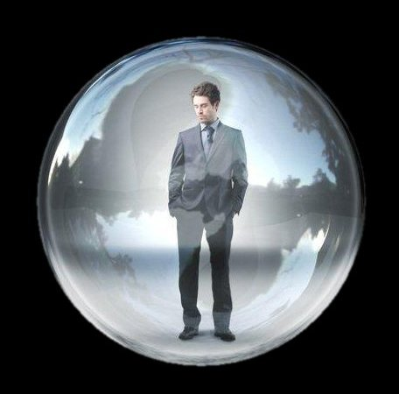
Question: How to compare pattern and body sizes for distance estimation?
Height or width alone might be misleading.
Some form of (3D) spatial simplification is needed, like
cube
rectangular prism
cylinder
sphere (probably the easiest math)
Uncertainty should be modeled.
Distance Estimation
Solution:
pattern circle <---> body sphere

Slide 32
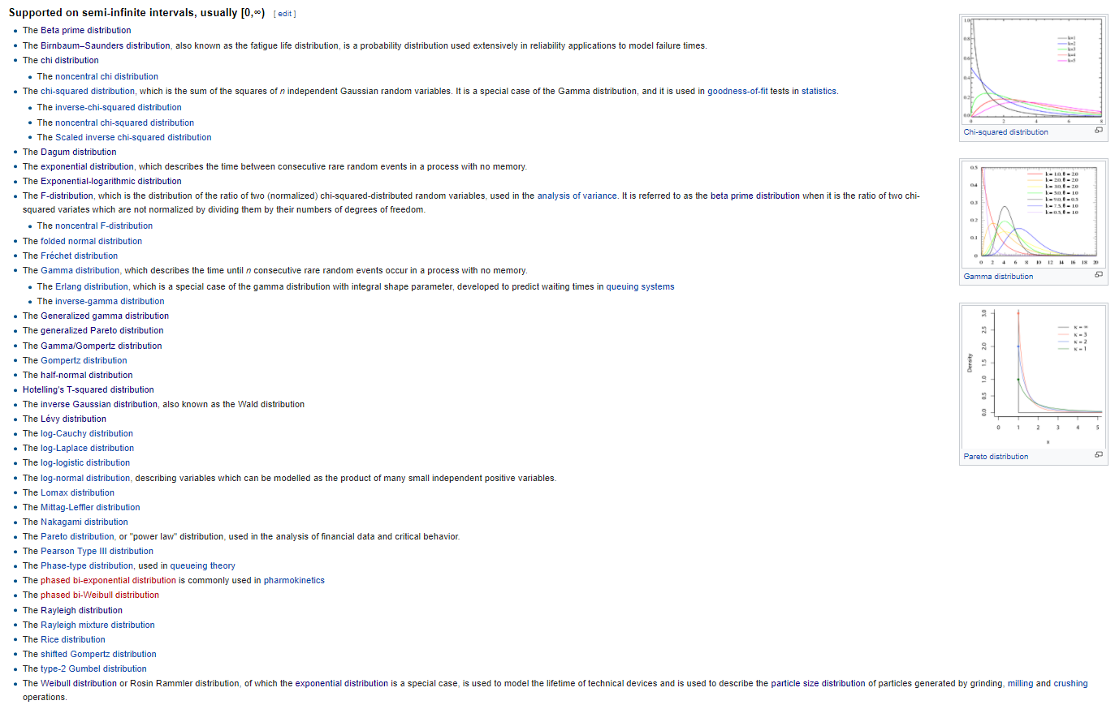
Body size distribution
Distibution should
be defined in [0,∞]
mode > 0
simple
skew controllable
Distance Estimation

Slide 33
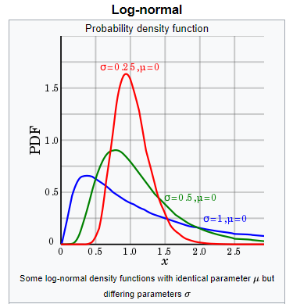
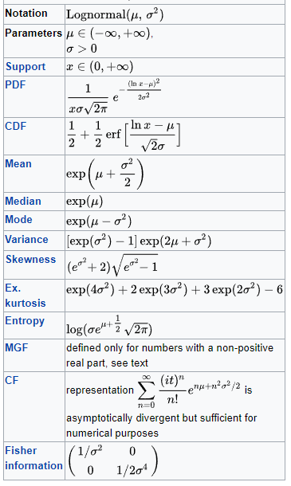
Log-normal distribution
Distance Estimation
Used in the context of describing human height distribution

Slide 34
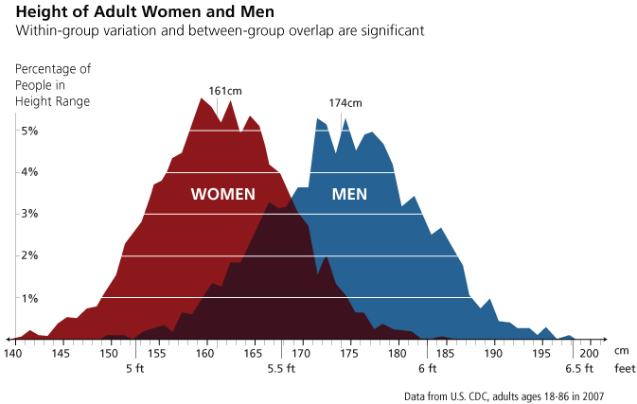
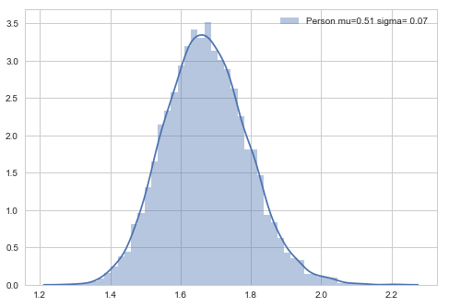
Example: Person
Distance Estimation

Slide 35
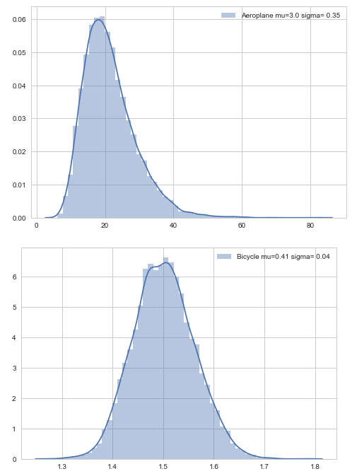
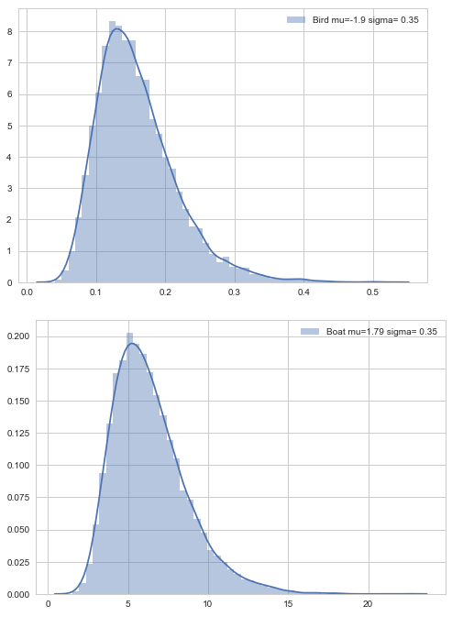
Bubble diameters (2*radius)
Distance Estimation

Slide 36
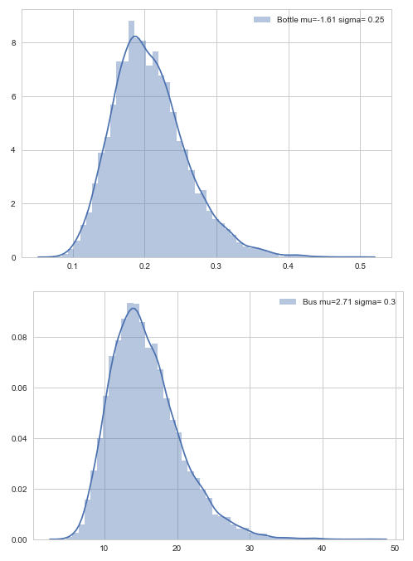
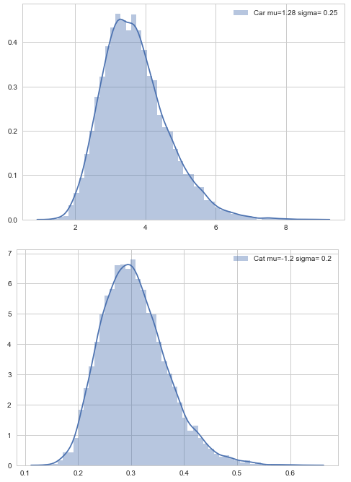
Bubble diameters (2*radius)
Distance Estimation

Slide 37
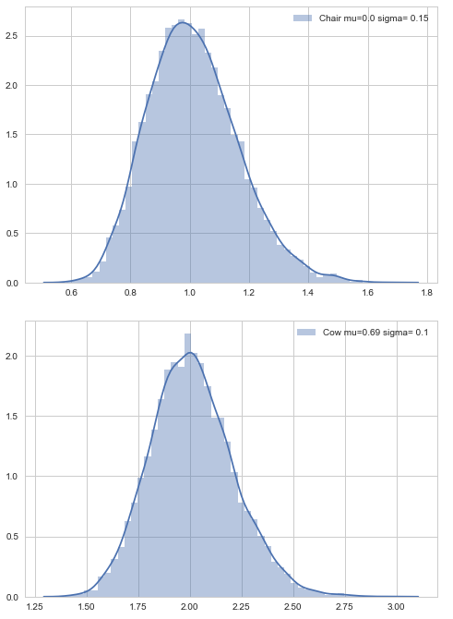
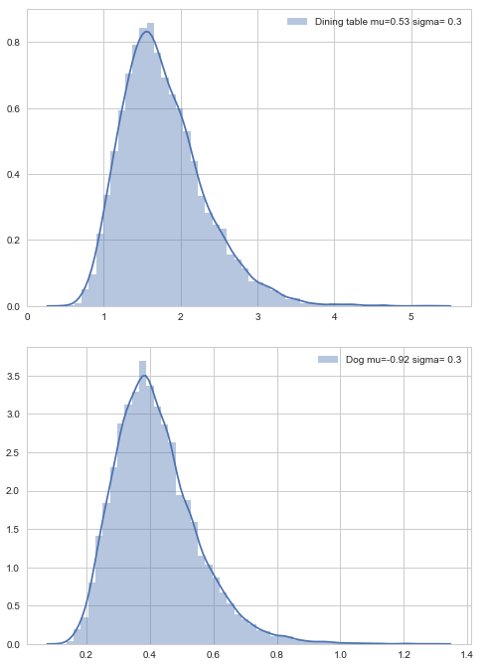
Bubble diameters (2*radius)
Distance Estimation

Slide 38
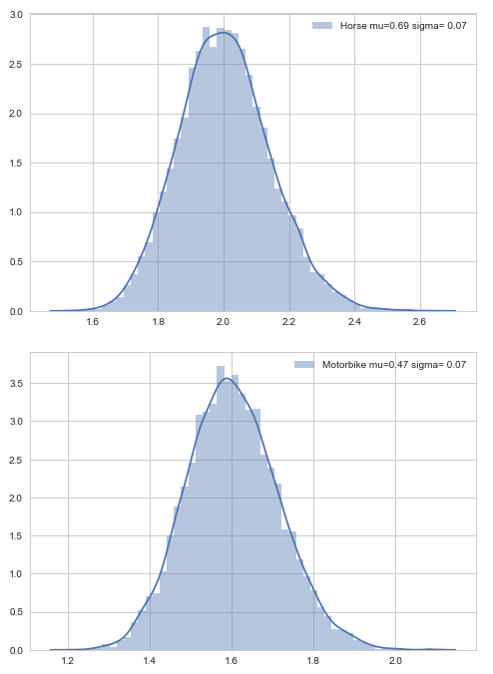
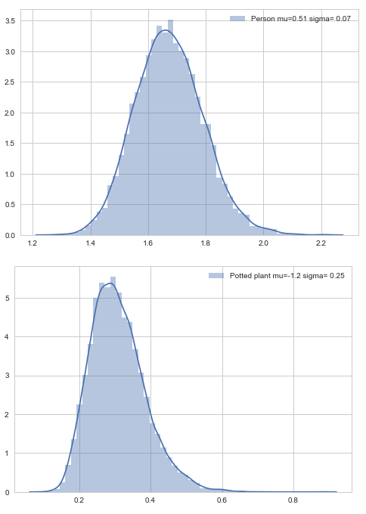
Bubble diameters (2*radius)
Distance Estimation

Slide 39


Bubble diameters (2*radius)
Distance Estimation

Slide 40





Radius of enclosing circle (pattern)
Distance Estimation
w
α
r
h
From bounding box coordinates to radius:
$$r=\sqrt{{(\frac{w}{2})}^{2}+{(\frac{h}{2})}^{2}}$$
$$h=(ymax−ymin)$$
$cy=(ymax+ymin)$/2
$$w=(xmax−xmin)$$
$$cx=(xmax+xmin)/2$$

Slide 41


Distance estimation using pattern circle and body sphere
Distance Estimation
$$d=\frac{f∗r}{\cos\left(α\right)∗\cos\left(\text{β}\right)∗r\text{i}∗\text{s}\text{h}\text{/}\text{p}\text{h}}$$
s_{h}$=sensor height \left(m\right)$
p_{h}= image height (pixels)
r_{i} = pattern radius (pixels)
r = body radius (m), mean from class specific distribution
f = focal length (m)
$α$ = altitude (rad)
β = azimuth (rad)

Slide 42
Distance Estimation
Remarks:
Video metadata often lacks sensor and focal parameters
Focal length can change during shooting (zooming)

Slide 43





x_{b},y_{b},z_{b} = body center point
3D Projection
y
x_{p},y_{p},z_{p} = pattern center point
x
z
From pixel coordinates px_{p}, py_{p} (sensor plane) to 3d camera coordinates:
s_{w}$=sensor width \left(m\right)$
s_{h}$=sensor height \left(m\right)$
p_{w}= image width (pixels)
p_{h}= image height (pixels)
r_{i} = pattern radius (pixels)
r = body radius (m)
f = focal length (m)
$α$ = altitude (rad)
(x_{p}, y_{p}, z_{p}) = (- $\frac{s_{w}}{2}+pxp$* $\frac{s_{w}}{pw}$, $\frac{s_{h}}{2}−pyp$* $\frac{s_{h}}{ph}$, -f)
Body center will be on the line:
(x_{b}, y_{b}, z_{b}) = t* (x_{p}, y_{p}, z_{p})
Distance to the body is:
$$d=\frac{f∗r}{\cos\left(α\right)∗\cos\left(\text{β}\right)∗\text{r}\text{i}∗\text{s}\text{h}\text{/}\text{p}\text{h}}$$
$α=$ arc tan(y_{p}/f)
$β=$ arc tan(x_{p}/f)

Slide 44





So:
$$t^{2}∗({x_{p}}^{2}+{y_{p}}^{2}{{+z}_{p}}^{2})=d^{2}$$
3D Projection
$$t=\frac{d}{\sqrt{{x_{p}}^{2}+{y_{p}}^{2}{{+z}_{p}}^{2}}}$$
Solving for t:
(x_{b}, y_{b}, z_{b}) = t* (x_{p}, y_{p}, z_{p})
Where:
(x_{p}, y_{p}, z_{p}) = (- $\frac{s_{w}}{2}+pxp$* $\frac{s_{w}}{pw}$, $\frac{s_{h}}{2}−pyp$* $\frac{s_{h}}{ph}$, -f)
$$t=\frac{d}{\sqrt{{x_{p}}^{2}+{y_{p}}^{2}{{+z}_{p}}^{2}}}$$
$$d=\frac{f∗r}{\cos\left(α\right)∗\cos\left(\text{β}\right)∗\text{r}\text{i}∗\text{s}\text{h}\text{/}\text{p}\text{h}}$$

Slide 45








Example:
s_{w}$=sensor width \left(m\right)$ = 0.0359 m
s_{h}$=sensor height \left(m\right)=0.0240 m$
p_{w}= image width (pixels) = 7360
p_{h}= image height (pixels) = 4912
r_{i} = pattern radius (pixels) = 100
r = body radius (m) = 1.0 m
f = focal length (m) = 0.050 m
x_{p} = 1200
y_{p} = 2000
3D Projection
(x_{p}, y_{p}, z_{p}) = (- $\frac{s_{w}}{2}+xp$* $\frac{s_{w}}{pw}$, $\frac{s_{h}}{2}−yp$* $\frac{s_{h}}{ph}$, -f)
= (- $\frac{0.0359}{2}+1200$* $\frac{0.0359}{7360}$, $\frac{0.0240}{2}−yp$* $\frac{0.0240}{4912}$, -0.050)
= (-0.0121, 0.0022, -0.0500)
$α=$ arc tan(y_{p}/f) = 0.0445
$β=$ arc tan(x_{p}/f) = -0.2374
$$d=\frac{f∗h}{\cos\left(α\right)∗\cos\left(\text{β}\right)∗\text{h}\text{i}∗\text{s}\text{h}\text{/}\text{p}\text{h}}$$
$=\frac{0.050∗1}{\cos\left(\text{0.0445}\right)∗\cos\left(\text{−0.2374}\right)∗\text{100}∗\text{0.0240}\text{/4912}}$ = 105.39
$t=\frac{\text{105.39}}{\sqrt{{\text{−0.0121}}^{2}+{\text{0.0022}}^{2}+{\text{−0.0500}}^{2}}}$ = 2.0468e+03
(x_{b}, y_{b}, z_{b}) = t* (x_{p}, y_{p}, z_{p})
= 2.0468e+03 * (-0.0121, 0.0022, -0.0500)
= (-24.7593, 4.5602, -102.3389)

Slide 46
Body Filtering
Enables prediction, including collision detection
Second order model does not work, constant acceleration makes bodies bounce back or get enormous velocities
In real world, constant acceleration for several (tens) of seconds is not common
First order model works! (No wonder it’s popular in robotics…)
When measurement is lost, the body is switched into constant velocity mode

Slide 47

Body Filtering

Slide 48

Body Filtering

Slide 49

Body Filtering

Slide 50
Example 1
Body Filtering

Slide 51




Body Filtering

Slide 52


Body Filtering

Slide 53

Example 2
Body Filtering

Slide 54




Body Filtering

Slide 55


Body Filtering

Slide 56





Body Prediction
A
μ
∆ has to be smaller than 1/fps. If fps=25, 1/fps = 0.04 sec. A car driving 120 km/h will proceed
1.33 meters and a collision with an observer might not be detected well enough. A value of ∆ = 0.01 corresponds to the movement of 33 cm for an object moving at 120 km/h. This will generate 100 values per prediction per second predicted. Prediction is done once per second for 10 seconds horizon. This will generate 1000 values per prediction. Only the current prediction for an object is kept in memory. Objects are predicted separately.

Slide 57

Body Prediction
Example of predicted paths

Slide 58





Collision with the observer
Collision Detection
r_{i}
nearest point μ_{i} on the predicted trajectory
t=t’
filter covariance estimate V_{i}
μ_{i}
d
O
For each body i, a random vector t is sampled
and distance to the observer calculated (center to center).
If the distance is less than r_{i}+r, collision occurred. The proportion of collisions to all cases is the (maximum) probability estimate for the body/observer collision.
r
From Kalman filter
Class specific
m=1000
Collisions
Note! Collision might occur earlier. This algorithm estimates the maximum probability on the path. Should minimum time be used? Or both?

Slide 59



Example
Collision Detection

Slide 60

Example
Collision Detection

Slide 61


Open questions:
Collisions between all bodies?
Min time or max probability or both?
More efficient sampling?
Collision Detection
Note:
Min distance and corresponding
time could be calculated without
step by step prediction

Slide 62
The Big Picture

Slide 63







Matching
Pattern filtering
Distance estimation
3D projection
Body filtering
Body prediction
Collision detection
…
CNN + Object Detection
Visual Analysis
Bodies (+attributes)
Context
Forecasts
Collision probabilities
Other representations
Voice
High female
Low female
Semantic Segmentation
High male
Low male
Commands Questions
Speech Generation
Speech Synthesis
Words per minute: max 150…160
Priority queue, active dropping
Speech Recognition
Speech Analysis
Q/A: (Answer voice: NOTICE)
Syntactic classification
Semantic classification
Generated based on situation:
Commands:

Slide 64
Next Steps

Slide 65
Kalman filter parameter adjustments (Q1)
Dataset selection (Q1)
Stereo vision (Q2)
Camera yaw, pitch, roll estimation (Q2)
Speech recognition (Q2)
Semantic segmentation (Q2)
Experiments in the wild (Q2)
Paper (Q3)
Speech analysis (Q3)
Speech generation (Q3)
Use cases (Q4)
Next steps

Slide 66
Kalman Filter Parameter Adjustments

Slide 67
Kalman Filter Parameter Adjustments
Use of detection instead of pattern when pattern is “reliable”?

Slide 68



Specification:
Video
Stereo
Distance information
Outdoor + indoor
Odometry
Dataset Selection
Open question: Indoor? Self generated?

Slide 69



Left
Right
Stereo Vision
disparity d
Disparity for “free” using left and right bounding boxes!!!!!!!!!!
If this works, stereo algorithm will be extremely fast and easy. Paper!!!
Rectification might still be needed?

Slide 70
Camera yaw, pitch, roll estimation
Can be estimated from background movement (average
optical flow)?

Slide 71
Speech Recognition
Which off-the-shelf network to use? Must be light and fast.

Slide 72

Semantic Segmentation
Why?
Object context (”person on grass”)
More exact localization for attribute extraction (”what color is person? red and white.”)
Which off-the-shelf network to use? Must be light and fast.

Slide 73

Distance estimation and 3D projection
Experiments in the Wild
Different locations and heights
Studio setup
Nikon D800E:
s_{w}$=sensor width \left(m\right)$ = 0.0359 m
s_{h}$=sensor height \left(m\right)=0.0240 m$
p_{w}= image width (pixels) = 7360
p_{h}= image height (pixels) = 4912
h = object height (m) = 1.5 m
f = focal length (m) = 0.020 m, varied
fov = $2∗atan⁡(\frac{s_{w}}{2∗f})$ = 83.81 ⁰

Slide 74

Body filtering
Experiments in the Wild
Car speeds:
0
20 km/h
40 km/h
60 km/h
80 km/h
Distances:
10 m
20 m
30 m
40 m
50 m
60 m
70 m
80 m
90 m
100 m
Outdoor setup
Laser distance measuring device would be nice…
Nikon D800E:
s_{w}$=sensor width \left(m\right)$ = 0.0359 m
s_{h}$=sensor height \left(m\right)=0.0240 m$
p_{w}= image width (pixels) = 7360
p_{h}= image height (pixels) = 4912
h = object height (m) = 1.5 m
f = focal length (m) = 0.050 m
fov = $2∗atan⁡(\frac{s_{w}}{2∗f})$ = 39.49 ⁰

Slide 75
Image-Based Situation Awareness: Estimating Object Locations, Velocities and Collision Probabilities Using Object Detection
Paper
Contents:
Abstract
Introduction
Related work
Our approach
Definitions
Detection
Matching
Pattern Filtering
Distance Estimation
3D Projection
Body Filtering
Body Prediction
Collision Detection
Experiments
Evaluation metric
Dataset
Results
Other experiments
Conclusion
???

Slide 76

Paper
Where to publish?
CVPR 2019 (6/2019, Long Beach, deadline 11/2018)
ICCV 2019 (29.10.-3.11.2019, Seoul, deadline 1/2019)

Slide 77



Algorithm has to pick
commands and questions
from word flow
…
…
Speech Analysis
Word2Vec?
Off-the-shelf
$$\left[\begin{matrix}0.567 & …. & 0.983\end{matrix}\right]$$
Syntactic Classifier (LSTM?)
Semantic Classifier (LSTM?)
These two networks need to be taught - data generation required

Slide 78
Speech Generation
?
Probably mostly rule-based. ML algorithms?

Slide 79
Example: Search chair
User | Application | Notes
speak to me | hello
what do you see | one chair one dining table
where is chair | right two point five meters | user turns right and steps forward
is chair free | yes | no objects detected nearby
repeat answer | ahead two point five meters | user steps forward
 | ahead two meters | user steps forward
 | ahead one point six meters | user steps forward
 | ahead zero point seven meters | user stops and finds chair
stop repeating
be quiet
Use Cases
Example: Give way
User | Application | Notes
 | danger person will collide move left | DANGER voice, person steps left
 | danger person will collide move left | DANGER voice, person steps left
 | warning person might collide move left | WARNING voice, person steps left
 | notice no collision | NOTICE voice
Examples here are very preliminary. ☺ We need tens of real use cases. Näkövammaisten Liitto?
Final commands and question alternatives are derived from use cases.
Used also as test cases.

Slide 80
Discussion

Slide 81
Thank you!
lampola@student.tut.fi
https://github.com/SakariLampola/Thesis

